Slide 1




CQRS with Erlang
presented by Bryan Hunter Firefly Logic
Twitter #erlang #cqrs
#strangeloop
@bryan_hunter
@fireflylogic

Slide 2
?

Slide 3
What and why CQRS?

Slide 4
CQRS is Command Query Responsibility Segregation.
> What is CQRS?

Slide 5
CQRS is an architectural pattern.
> What is CQRS?

Slide 6
Command Query Separation (CQS) applied to the “big”
void MutateSomeState(…); - or - MyResult GetWithoutTouching(…);
> What is CQRS?

Slide 7
CQRS is about separating reads from writes
> What is CQRS?

Slide 8
CQRS is about heresy
> What is CQRS?

Slide 9
Why CQRS?

Slide 10
> Why CQRS?
Domain Driven Design
Your heart says “it’s the right thing”
…but your brain says “you’re a big stinkin’ fraud”

Slide 11
> Why CQRS?
Bog standard
Layered Architecture
(not CQRS)
SQL
ORM
“Aggregate”<T> ☺
Repository<T>
DTOs
Two way data binding
load()
Client
save()

Slide 12
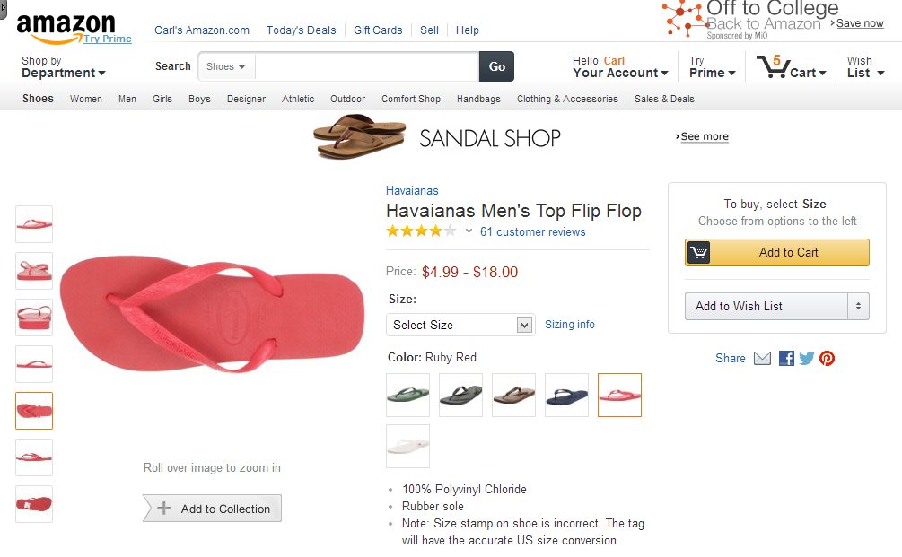
> How CQRS?
Task-based UI
Read store
Command

Slide 13
> How CQRS
Analytics store
CQRS
Event store
Queue
Read store
EventHandler
Event
EventHandler
EventHandler
Aggregate
DTO
Command Handler
Queue
Legacy store
Command
Client
Readonly
Command Builders
Tasks

Slide 14
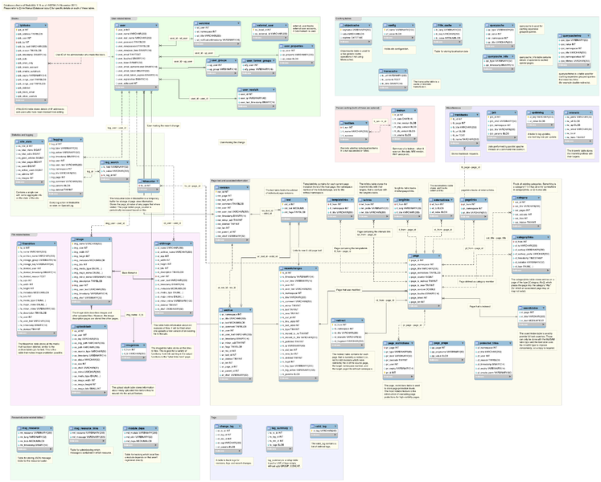
> Why CQRS?
keep your privates private

Slide 15
> Why CQRS
CQRS
Analytics store
Event store
Queue
Read store
EventHandler
Event
EventHandler
Aggregate
DTO
EventHandler
Command Handler
Queue
Command
Client
Readonly
Command Builders
Tasks

Slide 16
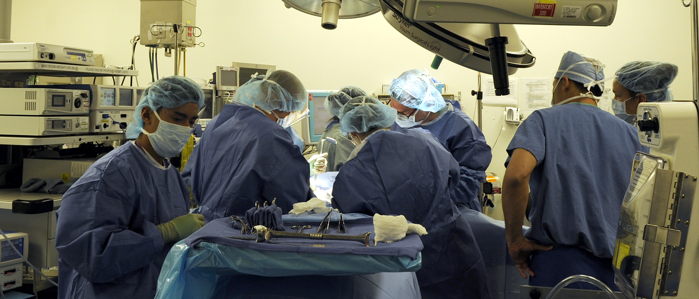
> Why CQRS?
returns focus to the business

Slide 17

> Why CQRS?
Vendor relationships should be consensual

Slide 18
> Why CQRS?
$
$
$
$
$
$
$
$
$
$
$
$
$
$
scaling up
scaling out
¢
¢
¢
¢
¢
¢
¢
¢
¢
¢

Slide 19
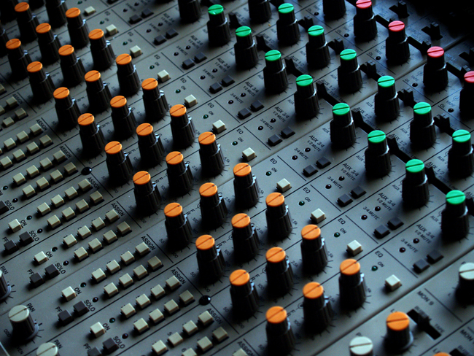
> Why CQRS?
explicit & tunable staleness

Slide 20
> Why CQRS?
Let the business tweak CAP
Partition tolerant
Consistent
Available

Slide 21
> Why CQRS?
simplify conflicts, read-write contention, and concurrency
9
0
1
2
3
4
5
6
7
8

Slide 22
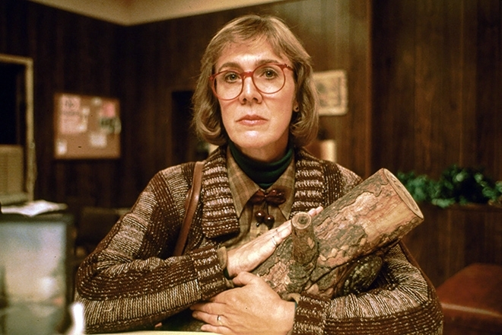
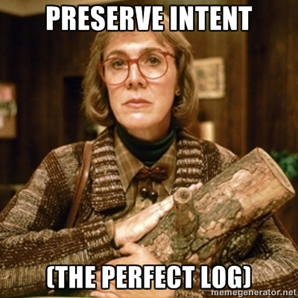
> Why CQRS?
http://memegenerator.net/Twin-Peaks-Log-Lady

Slide 23

> Why CQRS?
Our One chance to
to get it right
Big Design Upfront YAGNI Just-in-Time
Future-proof Maintenance

Slide 24
Why Erlang?

Slide 25
> Why Erlang?
Erlang is open, proven and cross-platform. It simplifies writing reliable, concurrent, distributed systems. Its pattern matching is A-OK.

Slide 26
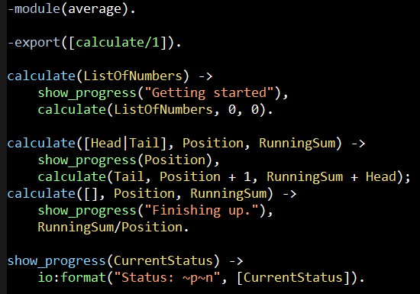
Erlang (the Language)
File: average.erl

Slide 27
Erlang (The VM)
.NET dev stack
Erlang dev stack
C# / F#
Erlang / Elixir / Joxa
.NET Framework
OTP
250+ years
CLR
ERTS
VM + Kernel
+ STDLIB
OS (Windows)
OS (Windows, Linux, Mac, None)

Slide 28
“The performance
of a concurrent language
is predicated by three things:
the context switching time,
The message passing time,
and the time to create a process.”
–Mike Williams

Slide 29
One Java 6 or .NET 4.0 Thread (allocates one megabyte)
**********
**********
**********
**********
**********
**********
**********
**********
**********
**********
**********
**********
**********
**********
**********
**********
**********
**********
**********
**********
**********
**********
**********
**********
**********
**********
**********
**********
**********
**********
**********
**********
**********
**********
**********
**********
**********
**********
**********
**********
**********
**********
**********
**********
**********
**********
**********
**********
**********
**********
Heap
Mailbox
Stack
**********
**********
**********
**********
**********
**********
**********
**********
**********
**********
**********
**********
**********
**********
**********
**********
**********
**********
**********
**********
**********
**********
**********
**********
**********
**********
**********
**********
**********
**********
**********
**********
**********
**********
**********
**********
**********
**********
**********
**********
**********
**********
**********
**********
**********
**********
**********
**********
**********
**********
Garbage Collector
Links and Monitors
One Erlang Process (allocates one kilobyte)
*
Why -> elsewhere concurrency is painful

Slide 30
*
*
*
Reductions
- Do 2,000 operations
reduction1 reduction3 .
Reduction2000
- Move to the next guy - Repeat
CPU Core
Why -> near zero context switching cost

Slide 31
worker
supervisor
*
*
CPU Core
Why -> supervision

Slide 32
***** *****
***** *****
***** *****
***** *****
Core
Core
Core
Core
Why -> elsewhere concurrency is painful

Slide 33

Distribution: built-in from the start

Slide 34

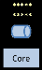
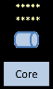
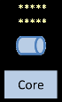
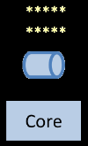
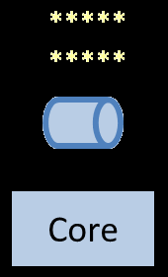
Distribution: built-in from the start

Slide 35
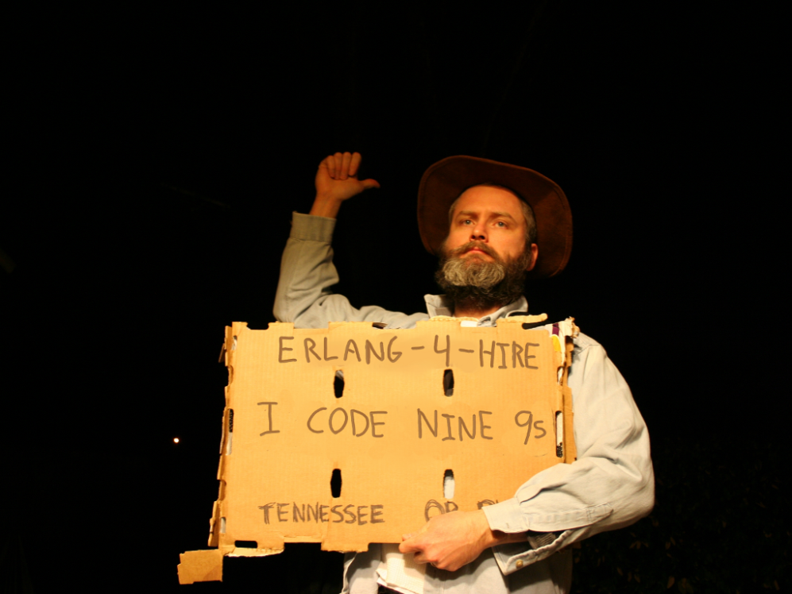
Nines | Uptime | Annual Downtime
9 | 99.9999999% | 30 milliseconds
8 | 99.9999990% | 300 milliseconds
7 | 99.9999900% | 3 seconds
6 | 99.9999000% | 32 seconds
5 | 99.9990000% | 5 minutes
4 | 99.9900000% | 53 minutes
3 | 99.9000000% | 8 hours, 46 minutes
2 | 99.0000000% | 3 days, 15 hours, 36 minutes
Safe
Supervisor
Worker
Worker
Links and monitors
No masters
Hot code loading
simple distribution, safe concurrency
Why -> reliability

Slide 36













When you reach for CQRS you are solving problems that led these companies
to
…to

Slide 37

[insert awe-inspiring demos here]
Notes:
http://www.dccomics.com/tv/super-friends-1973-1974

Slide 38
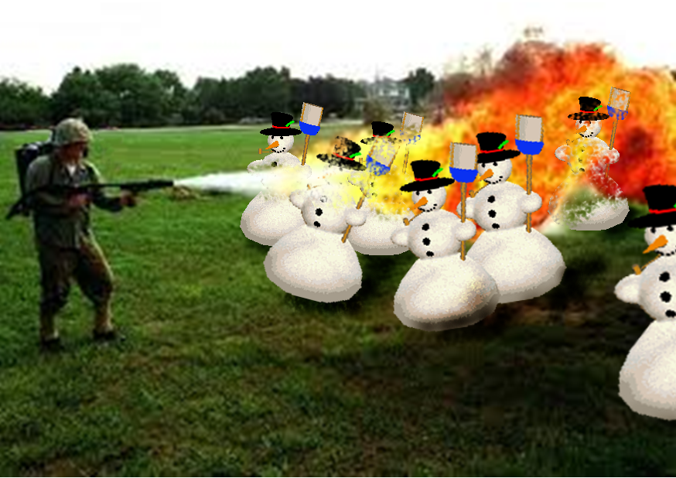
Right tool for the job!

Slide 39
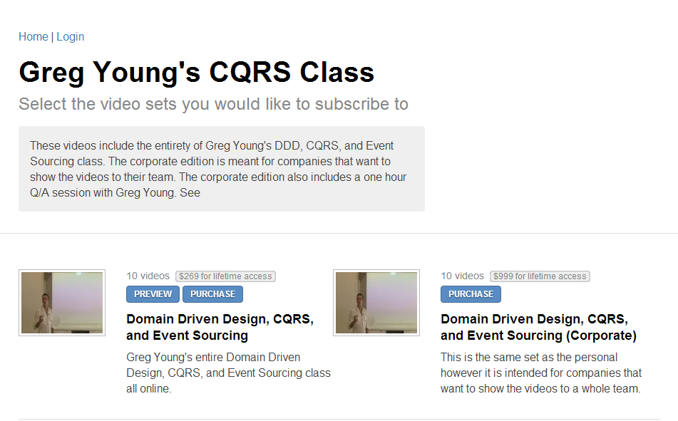

http://subscriptions.viddler.com/GregYoung
How -> watch some videos

Slide 40
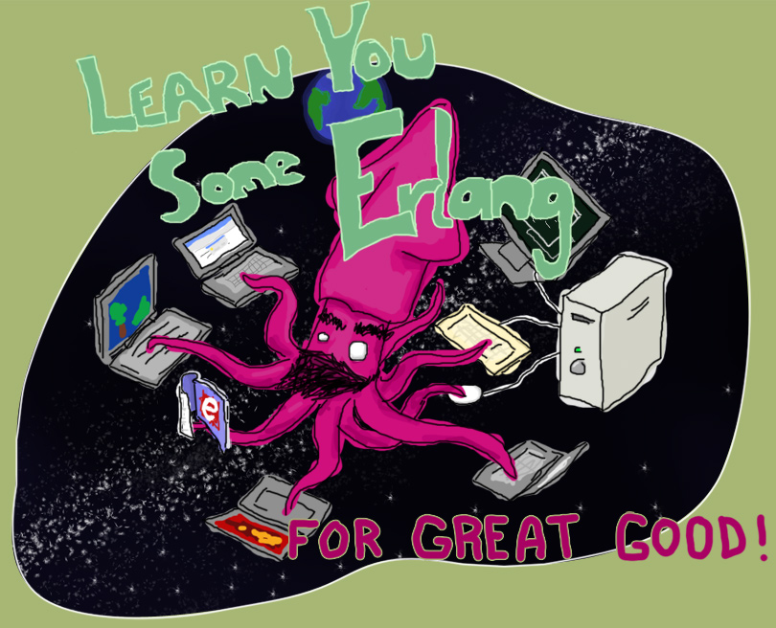
“Learn You Some Erlang for Great Good!” http://learnyousomeerlang.com/
How -> read this excellent and free online book

Slide 41



Start here
How -> read some books

Slide 42

http://erlangcamp.com
How -> Two day intense hands-on training

Slide 43

http://nashfp.org
How -> Better yet; pack up and move to Nashville!

Slide 44
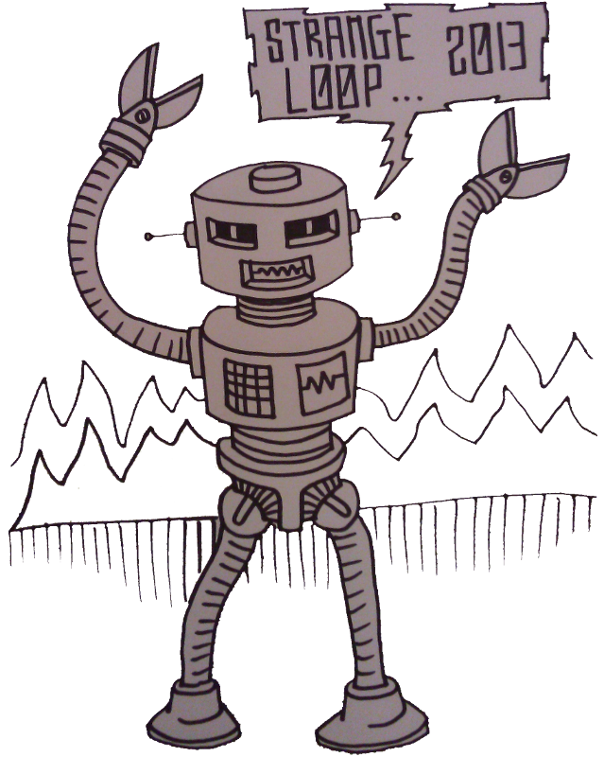
Thanks!
Bryan Hunter
Twitter: @bryan_hunter
Email: bryan.hunter@fireflylogic.com
Firefly Logic, Inc.
1000 Main Street #201 Nashville, TN 37206
http://fireflylogic.com
> keep in touch

